Slide 1

College of Information
Computational environment and resources
Haihua Chen, Ph.D.
Department of Information Science, UNT
Aug 16, 2024

Slide 2
Content:
Introduction to GitHub
Introduction to Google Colab
Introduction to Anaconda and PyCharm
Introduction to Python Tools for Scientific Computing
Introduction to Python Tools for Natural Language Processing
Introduction to Python Tools for Machine Learning and Deep Learning
Introduction to Computational Resources in the Lab

Slide 3
Content:
Introduction to GitHub
Introduction to Google Colab
Introduction to Anaconda and PyCharm
Introduction to Python Tools for Scientific Computing
Introduction to Python Tools for Natural Language Processing
Introduction to Python Tools for Machine Learning and Deep Learning
Introduction to Computational Resources in the Lab

Slide 4


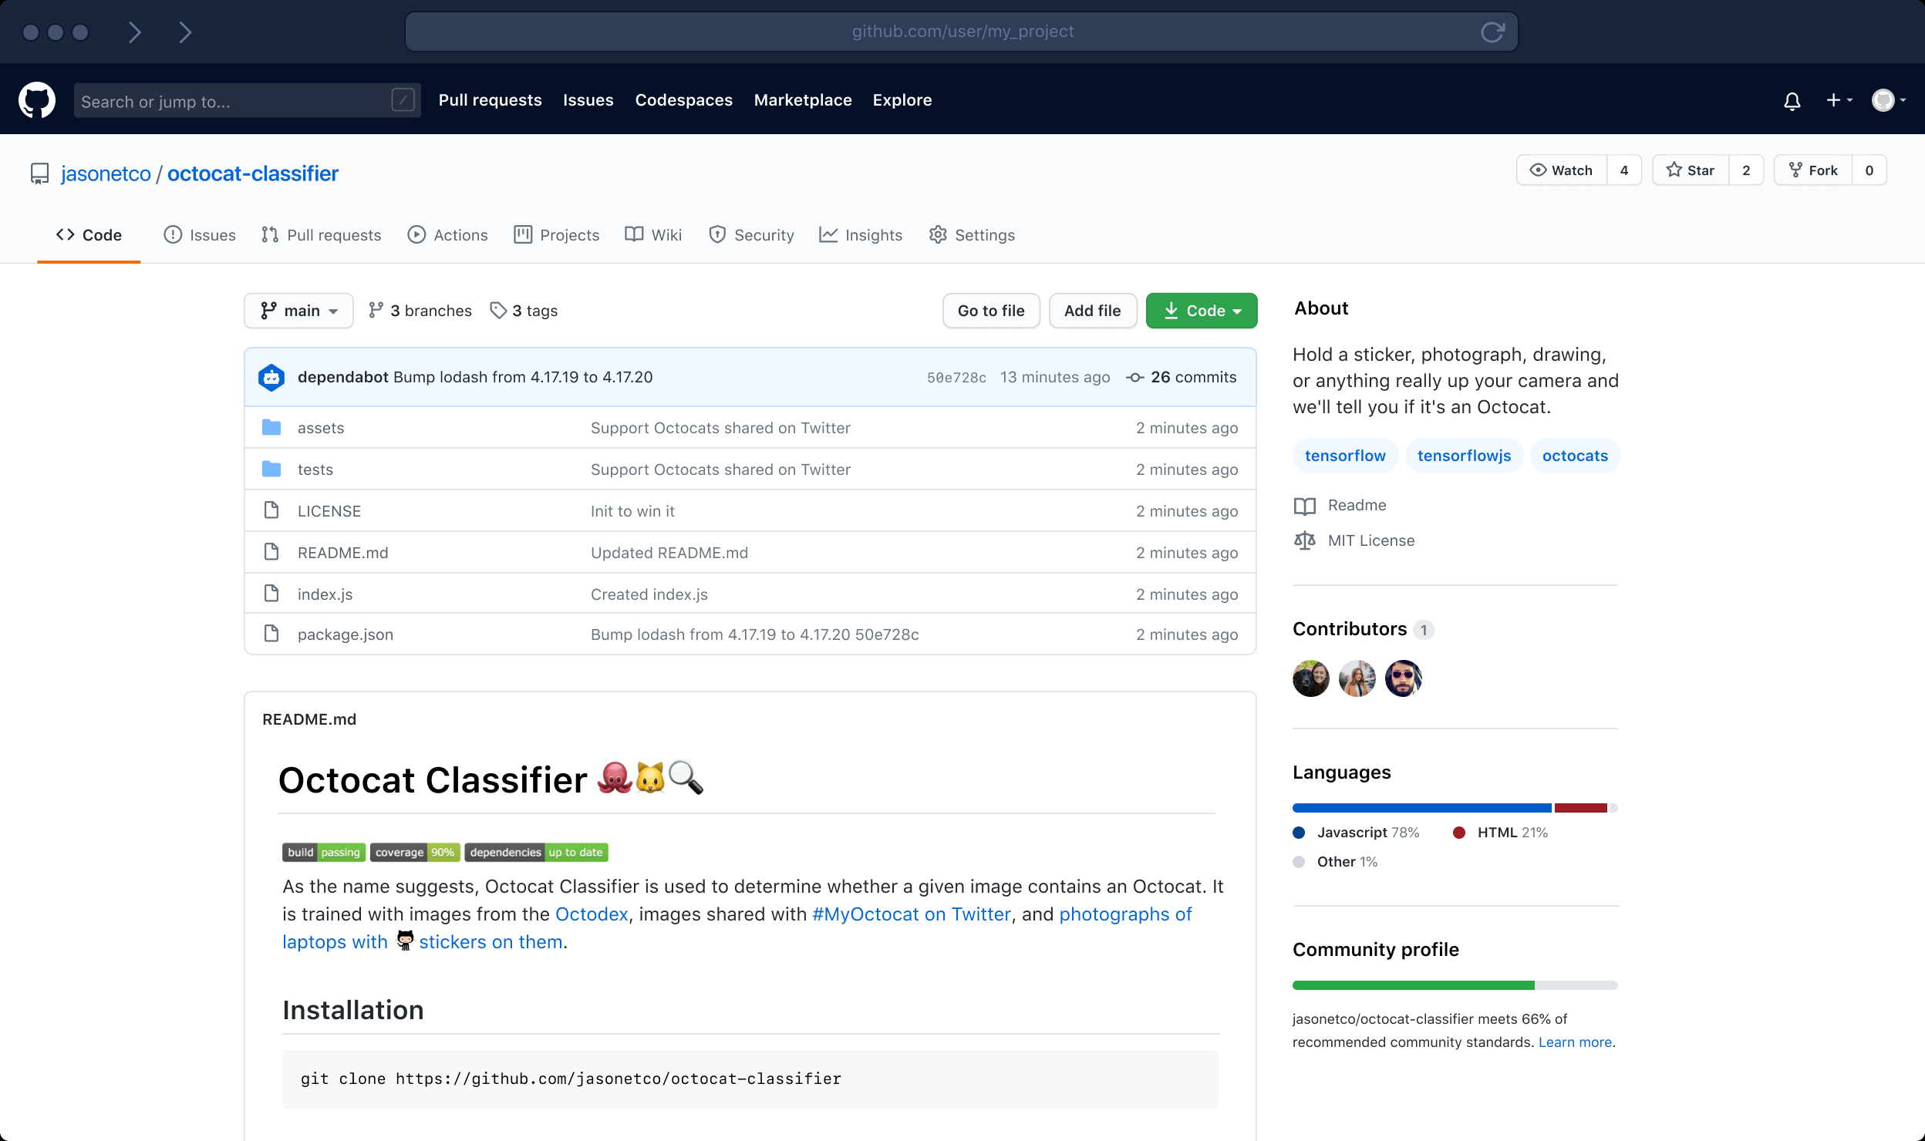
What is GitHub?
GitHub is a code hosting platform for version control and collaboration. It lets you and others work together on projects from anywhere. Over 65 million developers shape the future of software, together.
Notes:
This tutorial teaches you GitHub essentials like repositories, branches, commits, and Pull Requests: https://guides.github.com/activities/hello-world/

Slide 5
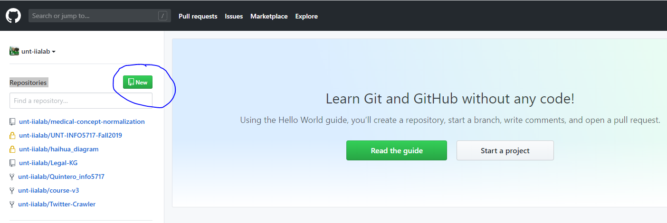
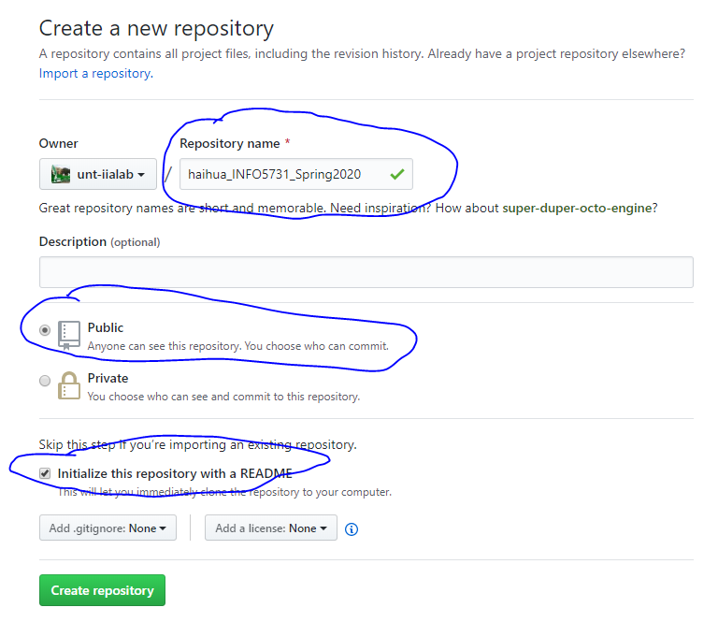
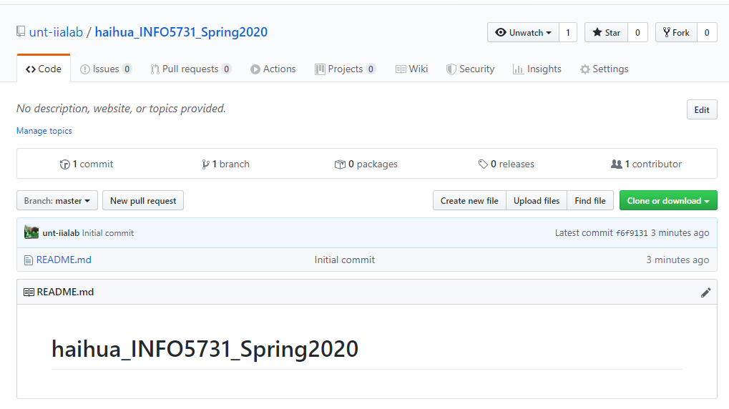
How to create a GitHub project?
Step 1: Create an account on GitHub: https://github.com/
Step 2: Create a new repository for this course with a common convention for naming as follows: for example, your first name_INFO5731_Spring2020

Slide 6
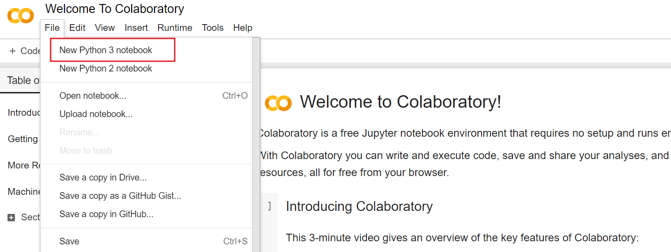
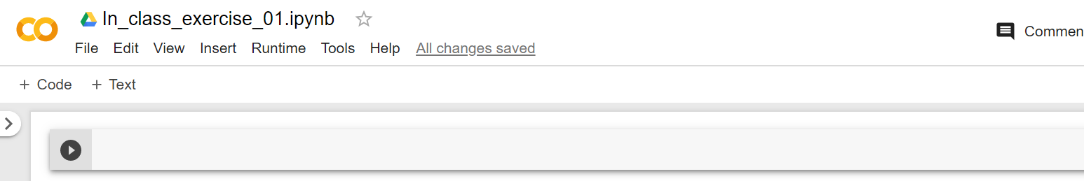
How to create a GitHub project?
Step 3: Login Google Colab with your Google account by clicking this link: https://colab.research.google.com/notebooks/welcome.ipynb#
Step 4: Create the first .ipynb file by click “File” to choose “New Python 3 notebook” to write your python code:
Rename the file, for example, “in_class_exercise_01”:

Slide 7
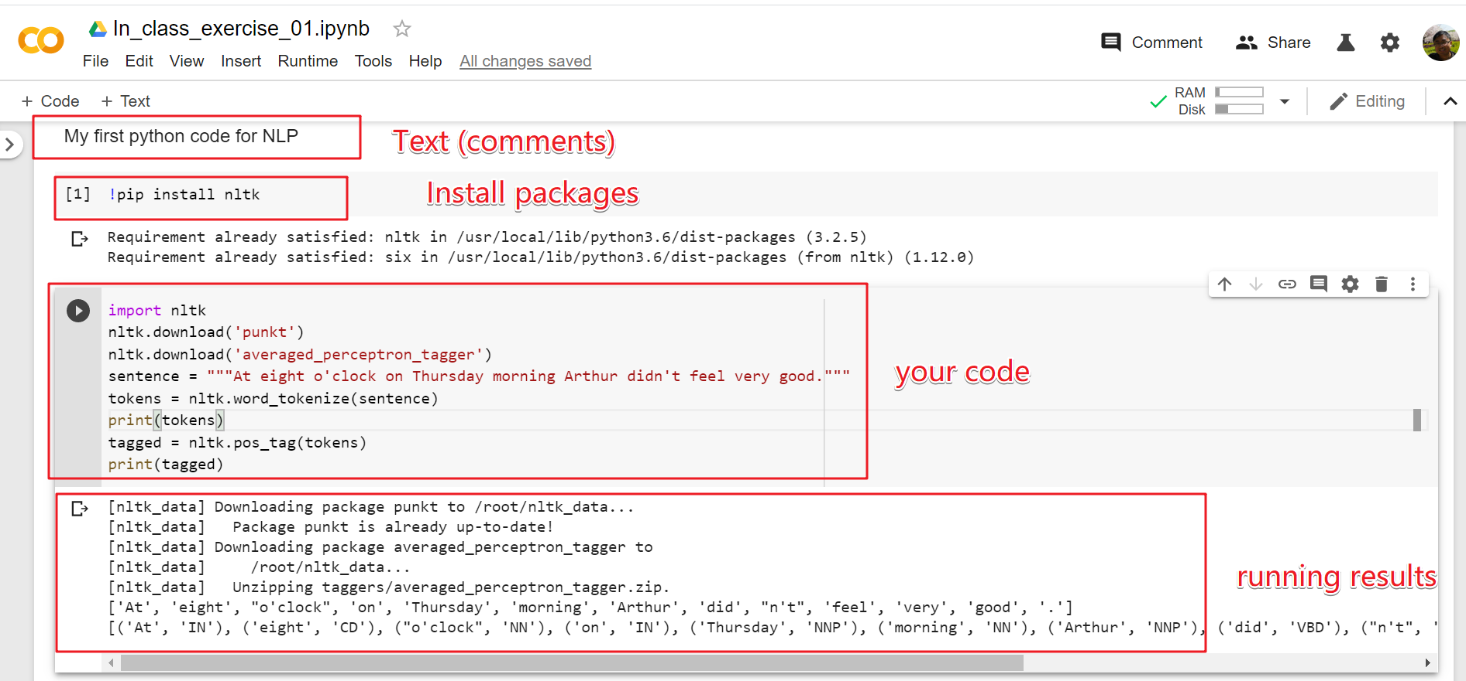
How to create a GitHub project?
Then add Code module by clicking “+ Code” button or add Text module by clicking “+ Text” button.
Look at the following example:
Click “Run” under “Runtime” to run your code. Remember to save you code (by using Ctrl+S keyboard shortcut)

Slide 8
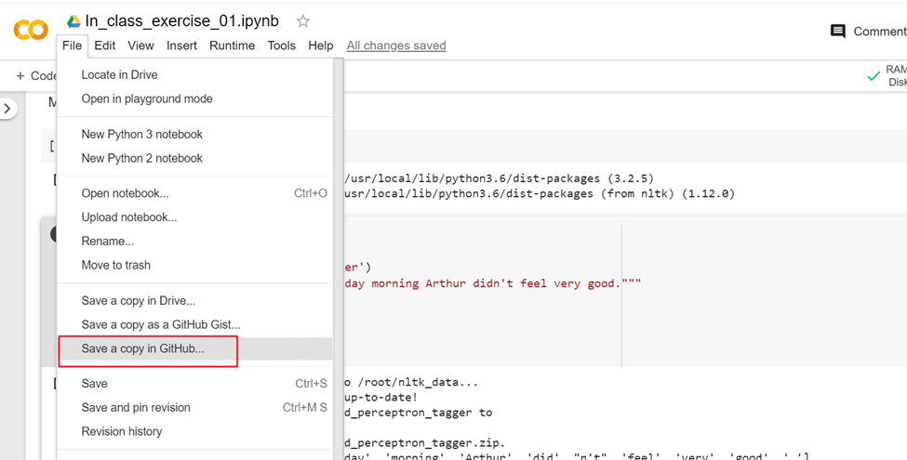
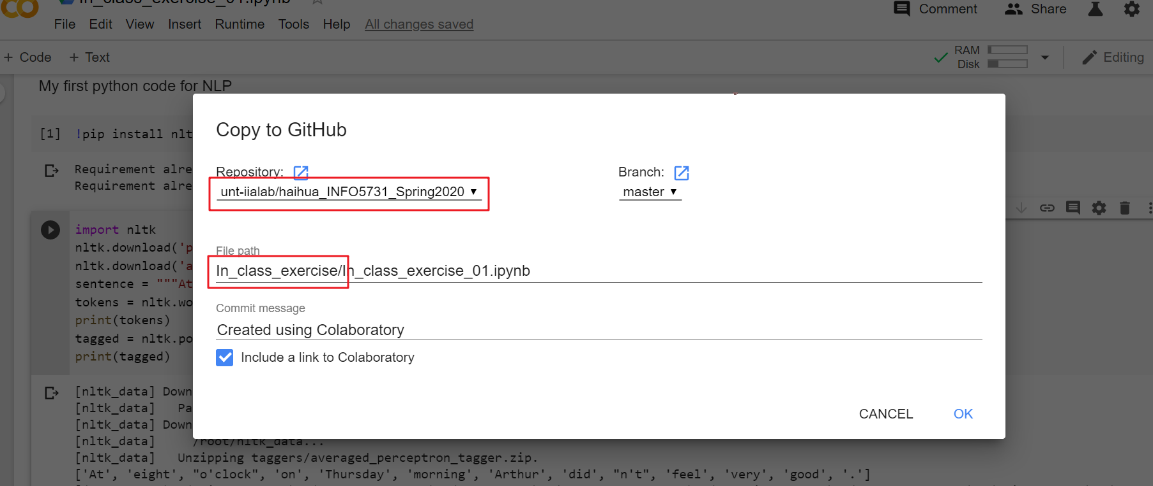
How to create a GitHub project?
Step 5: Save your code in the repository you have just created on GitHub.
Click “Save a copy in GitHub” under “File”, as shown below:
Select the repository you have just created for the course, and create a file path to your located file, as shown in the following screenshot:

Slide 9
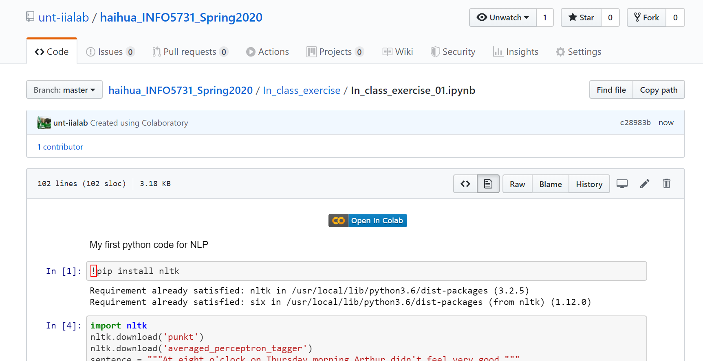
How to create a GitHub project?
Now your code has been saved successfully on GitHub:

Slide 10
Content:
Introduction to GitHub
Introduction to Google Colab
Introduction to Anaconda and PyCharm
Introduction to Python Tools for Scientific Computing
Introduction to Python Tools for Natural Language Processing
Introduction to Python Tools for Machine Learning and Deep Learning
Introduction to Computational Resources in the Lab

Slide 11
The history of Google Colab
Google is quite aggressive in AI research. Over many years, Google developed AI framework called TensorFlow and a development tool called Colaboratory. Today TensorFlow is open-sourced and since 2017, Google made Colaboratory free for public use. Colaboratory is now known as Google Colab or simply Colab.
Another attractive feature that Google offers to the developers is the use of GPU. Colab supports GPU and it is totally free. The reasons for making it free for public could be to make its software a standard in the academics for teaching machine learning and data science. It may also have a long-term perspective of building a customer base for Google Cloud APIs which are sold per-use basis.
Irrespective of the reasons, the introduction of Colab has eased the learning and development of machine learning applications.

Slide 12
What is Google Colab?
Write and execute code in Python
Document your code that supports mathematical equations
Create/Upload/Share notebooks
Import/Save notebooks from/to Google Drive
Import/Publish notebooks from GitHub
Import external datasets e.g. from Kaggle
Integrate PyTorch, TensorFlow, Keras, OpenCV
Free Cloud service with free GPU

Slide 13
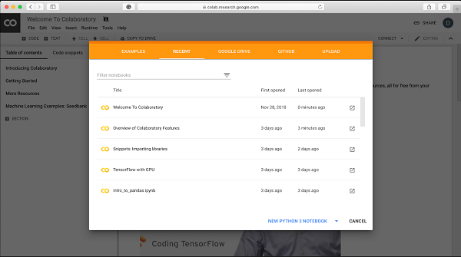
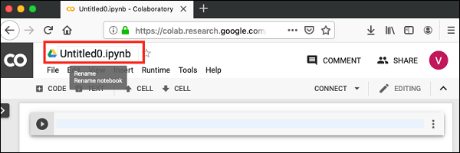
Your First Colab Notebook
Step 1 − Open the following URL in your browser − https://colab.research.google.com Your browser would display the following screen (assuming that you are logged into your Google Drive)
Step 2 − Click on the NEW PYTHON 3 NOTEBOOK link at the bottom of the screen. A new notebook would open up as shown in the screen below.

Slide 14
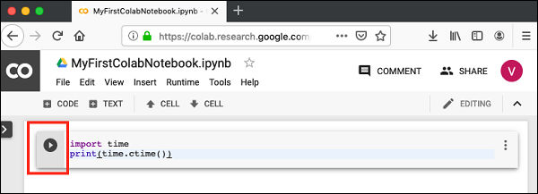
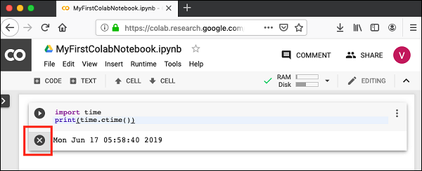
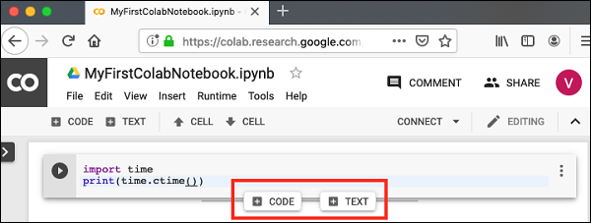
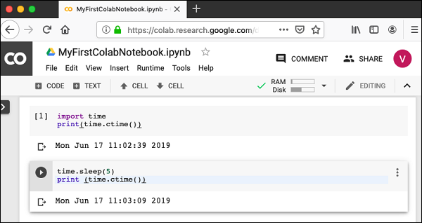
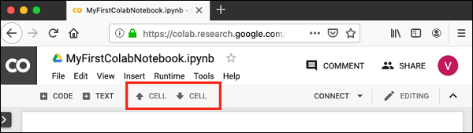
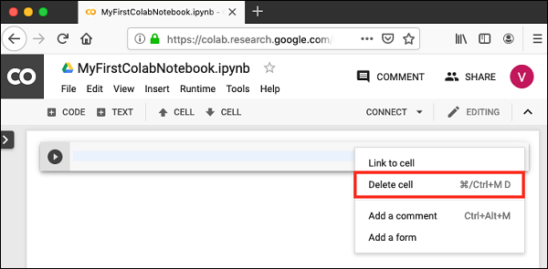
Your First Colab Notebook
Entering Code
Executing Code
Adding Code Cells
Run All
Changing Cell Order
Deleting Cell

Slide 15


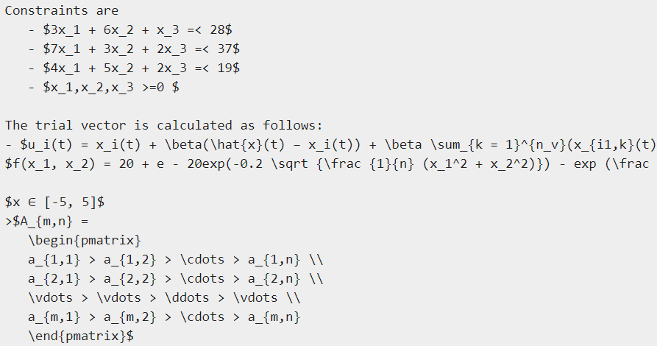
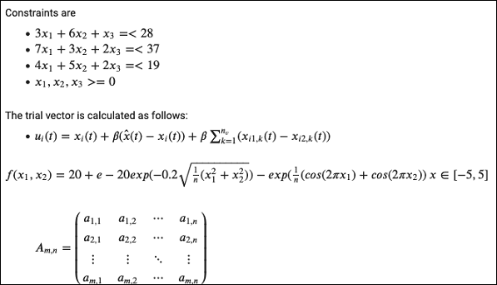
Documenting Your Code
Markdown Examples
Mathematical Equations
Code for Sample Equations

Slide 16


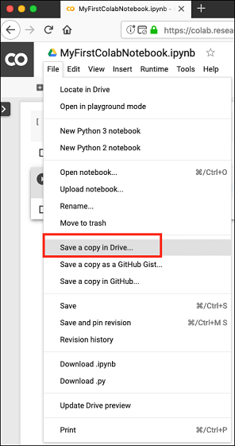


Saving Your Work
Saving to Google Drive
Saving to GitHub

Slide 17
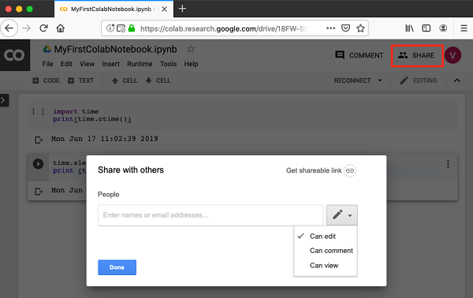
Sharing Notebook
You may enter the email IDs of people with whom you would like to share the current document. You can set the kind of access by selecting from the three options shown in the above screen.
Click on the Get shareable link option to get the URL of your notebook. You will find options for whom to share as follows −
Specified group of people
Colleagues in your organization
Anyone with the link
All public on the web

Slide 18
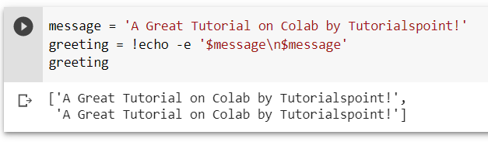
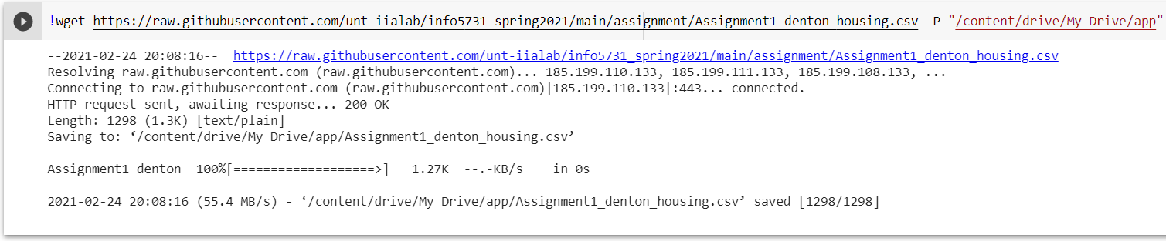
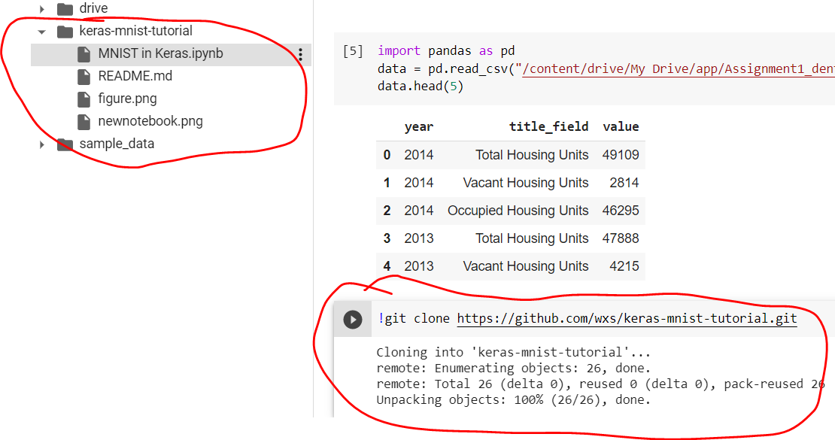
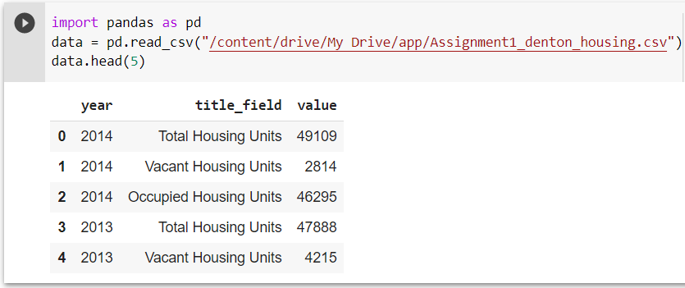
Invoking System Commands
Simple Commands
Getting Remote Data
Cloning Git Repository
System Aliases: !ls /bin

Slide 19
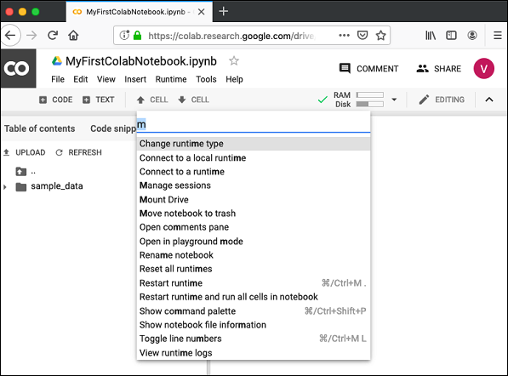
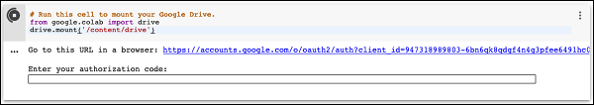
Executing External Python Files
Mounting Drive: Tools / Command palette
Type a few letters like “m” in the search box to locate the mount command. Select Mount Drive command from the list. The following code would be inserted in your Code cell.
If you run this code, you will be asked to enter the authentication code. The corresponding screen looks as shown below −

Slide 20

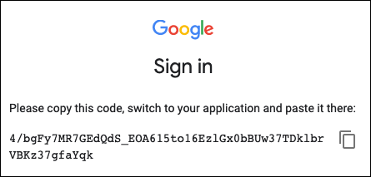
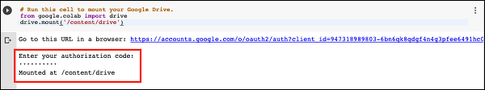
Executing External Python Files
Mounting Drive: Tools / Command palette
Open the above URL in your browser. You will be asked to login to your Google account. Now, you will see the following screen −
If you grant the permissions, you will receive your code as follows −
Cut-n-paste this code in the Code cell and hit ENTER. After a while, the drive will be mounted as seen in the screenshot below −
Now, you are ready to use the contents of your drive in Colab.

Slide 21
Executing External Python Files
Listing Drive Contents
You can list the contents of the drive using the ls command as follows − [!ls "/content/drive/My Drive/Colab Notebooks"]
This command will list the contents of your Colab Notebooks folder. The sample output of my drive contents are shown here − [Greeting.ipynb hello.py LogisticRegressionCensusData.ipynb LogisticRegressionDigitalOcean.ipynb MyFirstColabNotebook.ipynb SamplePlot.ipynb]
Running Python Code
Now, let us say that you want to run a Python file called hello.py stored in your Google Drive. Type the following command in the Code cell − [!python3 "/content/drive/My Drive/Colab Notebooks/hello.py"]
The contents of hello.py are given here for your reference − [print("Welcome to TutorialsPoint!")]
You will now see the following output − [Welcome to TutorialsPoint!]

Slide 22
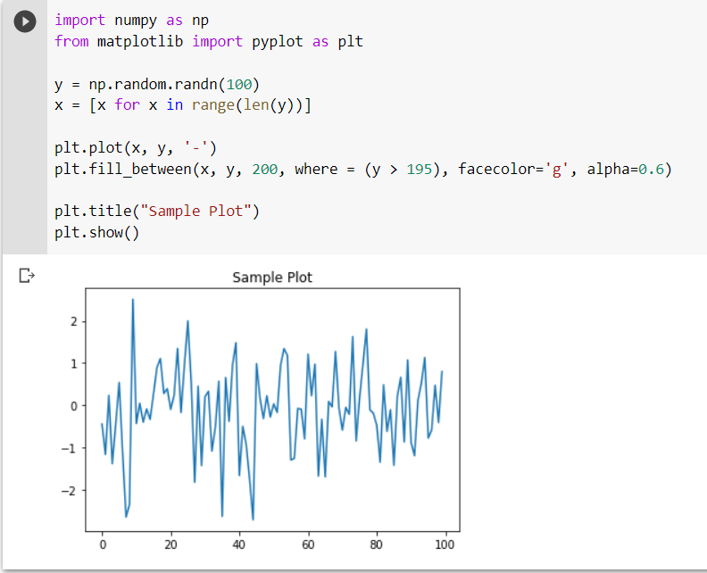
Graphical Outputs
Colab also supports rich outputs such as charts.

Slide 23
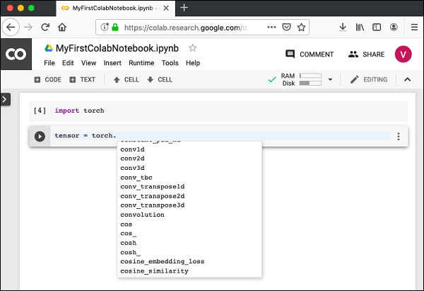
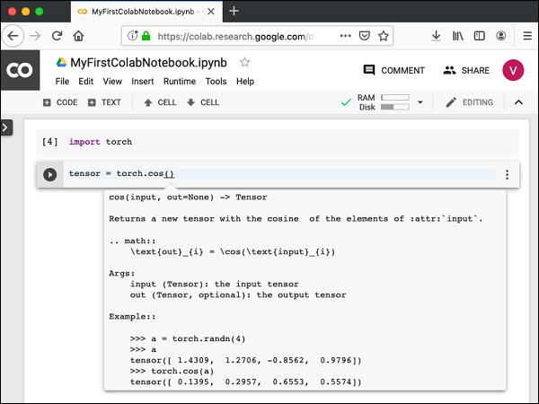
Code Editing Help
Function List
Step 1 − Open a new notebook and type in the following code in the Code cell −
Step 2 − Run the code by clicking on the Run icon in the left panel of the Code cell. Add another Code cell and type in the following code −
Function Documentation
Colab gives you the documentation on any function or class as a context-sensitive help.

Slide 24
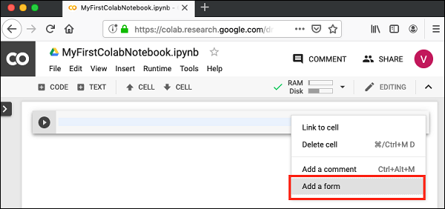
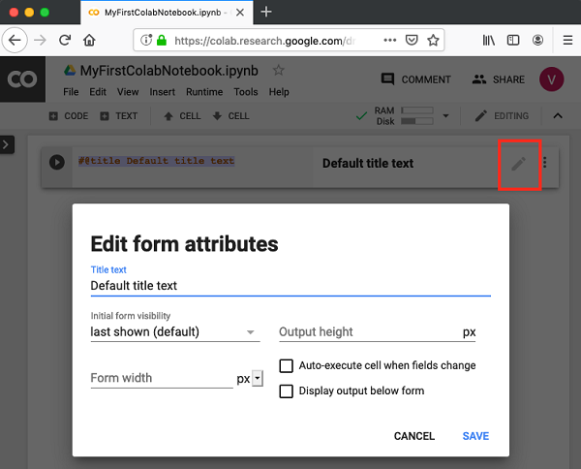
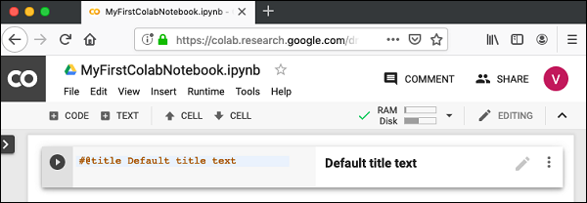
Adding Forms
Adding Form
Suppose, you want a user set time delay instead of a fixed delay of 5 seconds. For this, you can add a Form to the Code cell to accept the sleep time.
Open a new notebook. Click on the Options (vertically-dotted) menu. A popup menu shows up as seen in the screenshot below −
Now, select Add a form option. It will add the form to your Code cell with a Default title as seen in the screenshot here −
To change the title of the form, click on the Settings button (pencil icon on the right). It will pop up a settings screen as shown here:
Change the form title to “Form” and save the form. You may use some other name of your choice. Notice that it adds the @title to your code cell.

Slide 25
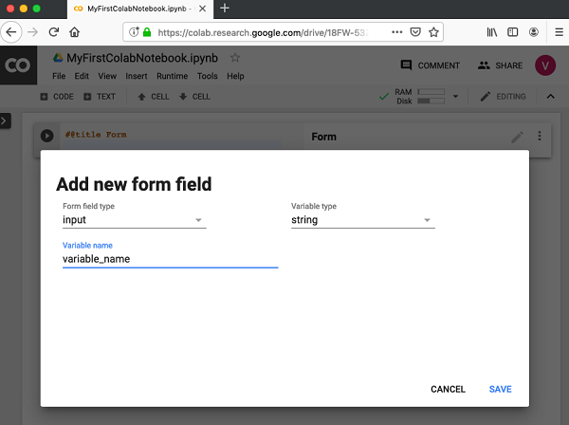
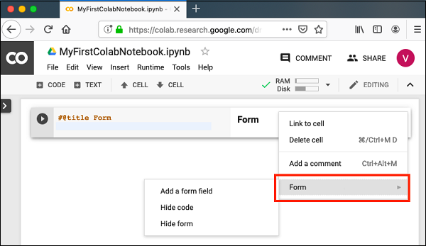
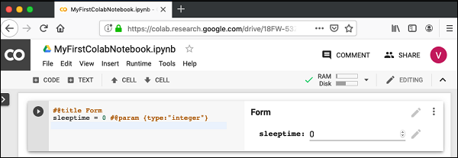
Adding Forms
Adding Form Fields
To add a form field, click the Options menu in the Code cell, click on the Form to reveal the submenus. The screen will look as shown below −
Select Add a form field menu option. A dialog pops up as seen here −
Leave the Form field type to input. Change the Variable name to sleeptime and set the Variable type to integer. Save the changes by clicking the Save button. Your screen will now look like the following with the sleeptime variable added into the code.

Slide 26
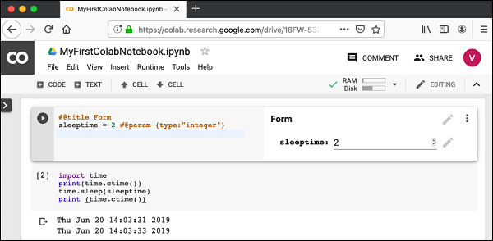


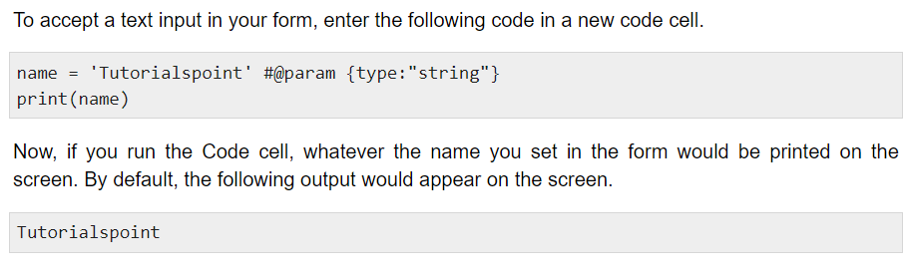
Adding Forms
Testing Form
Inputting Text
Dropdown List
Date Input

Slide 27
Installing ML Libraries
!pip install or !apt-get install
!pip install scikit-learn
!pip install -q keras
!pip3 install torch torchvision
!pip install tensorflow
!apt-get -qq install -y libsm6 libxext6 && pip install -q -U opencv-python
!pip install -q xgboost==0.4a30
!apt-get -qq install -y graphviz && pip install -q pydot
Python package index: https://pypi.org/

Slide 28
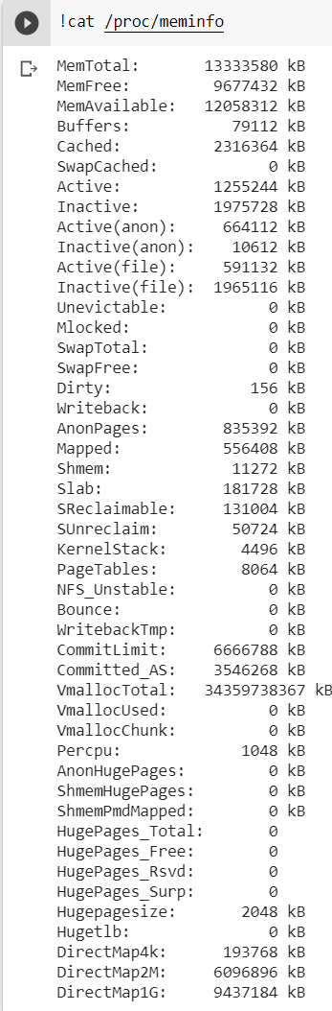
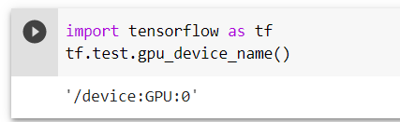
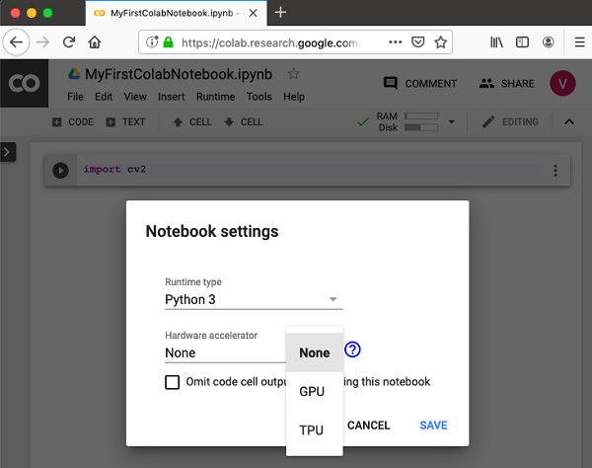
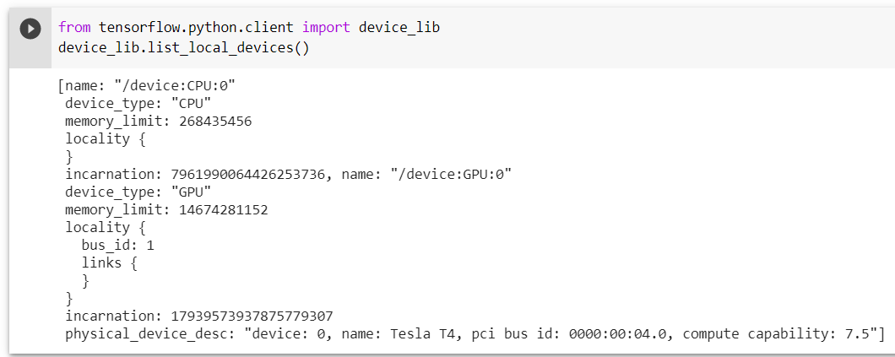
Using Free GPU
Enabling GPU
To enable GPU in your notebook, select the following menu options − [Runtime / Change runtime type]
Testing for GPU
Listing Devices
Checking RAM

Slide 29
Create your ML and DL models on Google Colab
Your First Machine Learning Model:
https://colab.research.google.com/drive/1oQdzTY2wVjO6LqTCUlzR5BN5GL905fRq#scrollTo=1yE1ar-m5yEv
Step-by-step: https://machinelearningmastery.com/machine-learning-in-python-step-by-step/
Datasets:
(1) https://archive.ics.uci.edu/ml/datasets.php
(2) https://www.paperswithcode.com/datasets?fbclid=IwAR3XPvQwYKwPdPoW7iisKiOAFjlLR9dfG7hPvSTHE0tisclT-dZxDvTxHHg
Code: https://github.com/maykulkarni/Machine-Learning-Notebooks
Your First Deep Learning Model:
https://colab.research.google.com/drive/1oQdzTY2wVjO6LqTCUlzR5BN5GL905fRq#scrollTo=1yE1ar-m5yEv
Step-by-step: https://machinelearningmastery.com/tutorial-first-neural-network-python-keras/
Datasets:
(1) https://archive.ics.uci.edu/ml/datasets.php
(2) https://www.paperswithcode.com/datasets?fbclid=IwAR3XPvQwYKwPdPoW7iisKiOAFjlLR9dfG7hPvSTHE0tisclT-dZxDvTxHHg
Code: https://neptune.ai/blog/how-to-use-google-colab-for-deep-learning-complete-tutorial

Slide 30
Content:
Introduction to GitHub
Introduction to Google Colab
Introduction to Anaconda and PyCharm
Introduction to Python Tools for Scientific Computing
Introduction to Python Tools for Natural Language Processing
Introduction to Python Tools for Machine Learning and Deep Learning
Introduction to Computational Resources in the Lab

Slide 31
How to use Anaconda and PyCharm?
Getting started with Anaconda:
https://docs.anaconda.com/anaconda/user-guide/getting-started/
Getting started with PyCharm:
https://www.jetbrains.com/help/pycharm/creating-and-running-your-first-python-project.html#edit-file

Slide 32
Content:
Introduction to GitHub
Introduction to Google Colab
Introduction to Anaconda and PyCharm
Introduction to Python Tools for Scientific Computing
Introduction to Python Tools for Natural Language Processing
Introduction to Python Tools for Machine Learning and Deep Learning
Introduction to Computational Resources in the Lab

Slide 33
Pandas + NumPy + Scipy + Matplotlib
Pandas is a package providing fast, flexible, and expressive data structures designed to make working with structured (tabular, multidimensional, potentially heterogeneous) and time series data both easy and intuitive.
Numpy is the core library for scientific computing in Python. It provides a high-performance multidimensional array object, and tools for working with these arrays.
SciPy builds on NumPy and provides a large number of functions that operate on NumPy arrays and are useful for different types of scientific and engineering applications.
Matplotlib is a comprehensive library for creating static, animated, and interactive visualizations in Python.

Slide 34
Pandas
What kind of data does Pandas handle?
How do I read and write tabular data?
How do I select a subset of a table?
How to create plots in pandas?
How to create new columns derived from existing columns?
How to calculate summary statistics?
How to reshape the layout of tables?
How to combine data from multiple tables?
How to handle time series data?
How to manipulate textual data?
Source: https://pandas.pydata.org/pandas-docs/stable/getting_started/index.html

Slide 35
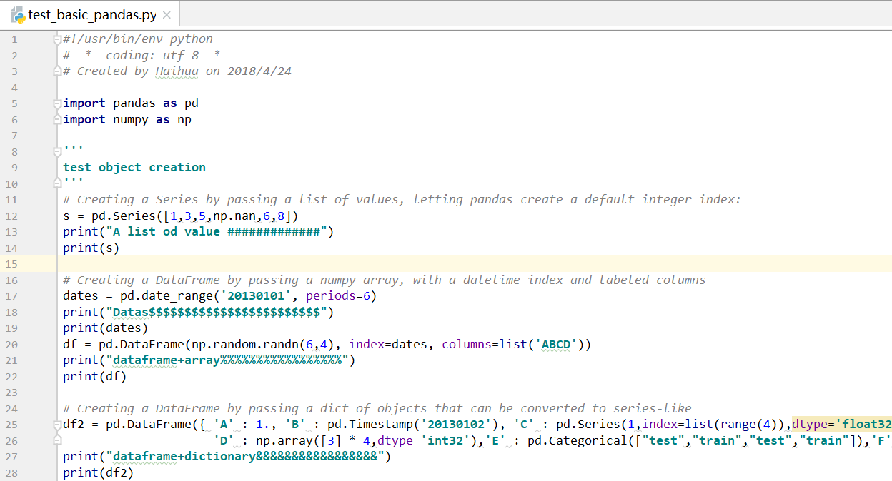
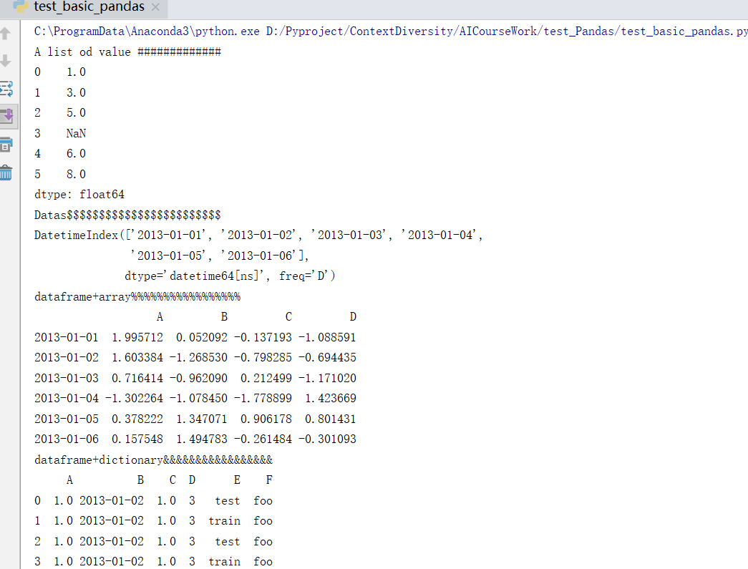
Object creation
点击添加标题
点击添加标题

Slide 36
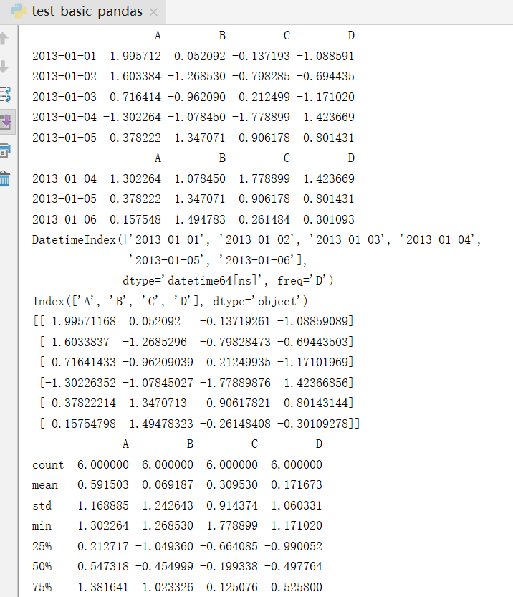
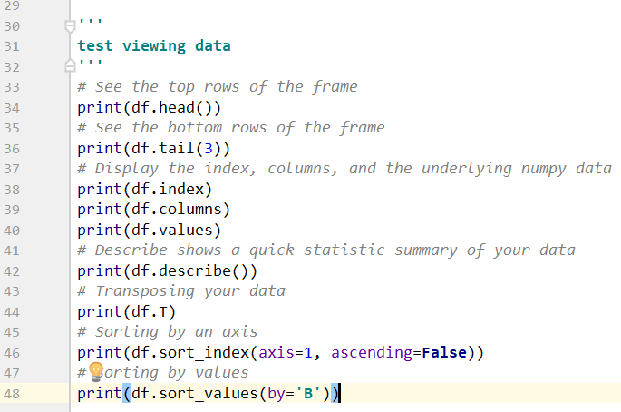
Viewing data

Slide 37
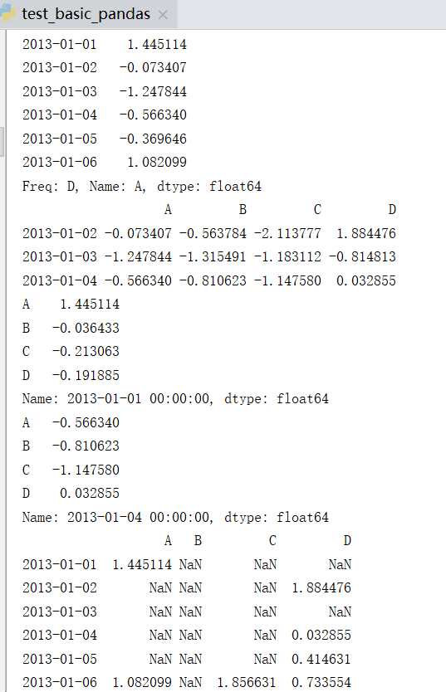

Selection
While standard Python / NumPy expressions for selecting and setting are intuitive and come in handy for interactive work, for production code, we recommend the optimized pandas data access methods.
There are many other functions for selection, I will send you some materials

Slide 38


Merge
Pandas provides various facilities for easily combining together Series, DataFrame, and Panel objects with various kinds of set logic for the indexes and relational algebra functionality in the case of join / merge-type operations.

Slide 39
Lessons for New pandas Users
01 - Lesson: - Importing libraries - Creating data sets - Creating data frames - Reading from CSV – Exporting to CSV - Finding maximums - Plotting data
02 - Lesson: - Reading from TXT - Exporting to TXT - Selecting top/bottom records - Descriptive statistics - Grouping/sorting data
03 - Lesson: - Creating functions - Reading from EXCEL - Exporting to EXCEL - Outliers - Lambda functions - Slice and dice data
04 - Lesson: - Adding/deleting columns - Index operations
05 - Lesson: - Stack/Unstack/Transpose functions
06 - Lesson: - GroupBy function
07 - Lesson: - Ways to calculate outliers
08 - Lesson: - Read from Microsoft SQL databases
09 - Lesson: - Export to CSV/EXCEL/TXT
10 - Lesson: - Converting between different kinds of formats
11 - Lesson: - Combining data from various sources

Slide 40
Fundamental package for scientific computing with Python
Efficient, In-memory, Contiguous, Homogeneous
N-dimensional array object
An ndarray is a multidimensional container of items of the same type and size. The number of dimensions and items in an array is defined by its shape, which is a tuple of N positive integers that specify the sizes of each dimension.
Linear algebra, Fourier transform, random number capabilities
Building block for other packages
SciPy, Pandas, Matplotlib, scikit-learn
suited to many applications
Image processing, Signal processing, Linear algebra, etc.

Slide 41





NumPy
点击添加标题
点击添加标题
Notes:
Figure1: Basic; Figure 2 (右边两个图): Slicing and More advanced slicing; Figure 3: Random, save to file and read from file; Figure 4: Arrays are mutable
The probability density function of Gaussian Distribution (正态分布的公式): numpy.random.normal(loc=0.0, scale=1.0, size=None)
loc：float 此概率分布的均值（对应着整个分布的中心centre）,相当于公式里面的μ值 scale：float 此概率分布的标准差（对应于分布的宽度，scale越大越矮胖，scale越小，越瘦高）, 相当于公式里面的σ值 size：int or tuple of ints 输出的shape，默认为None，只输出一个值

Slide 42



Attributes, arithmetic, vector
点击添加标题
Notes:
Figure1: The attributes of array;
Figure 2: The Basic arithmetic operations using numpy, (addition, subtraction, multiplication)
Figure 3: Vector operations (inner product, outer product, dot product or matrix multiplication)

Slide 43


Array broadcasting
点击添加标题
Notes:
Figure: Array broadcasting, which means that when operating on two arrays, numpy compares shapes. Two dimensions are compatible (兼容的) when (1) they are of equal size and (2) one of them is 1. This also allows us to add a constant to a matrix or multiply a matrix by a constant.

Slide 44


Matrix operations
Notes:
Matrix operations. First, define some matrices (Figure 1); Second, dot product (Figure 2)

Slide 45



Array operations along axes

Slide 46




Iterating over arrays
Single Array Iteration (red: reshaping array)
Controlling Iteration Order (‘K’, ‘C’, ‘F’)
Notes:
An important thing to be aware of for this iteration is that the order is chosen to match the memory layout of the array instead of using a standard C or Fortran ordering. This is done for access efficiency, reflecting the idea that by default one simply wants to visit each element without concern for a particular ordering. We can see this by iterating over the transpose of our previous array, compared to taking a copy of that transpose in C order.
There are times when it is important to visit the elements of an array in a specific order, irrespective of the layout of the elements in memory. The nditer object provides an order parameter to control this aspect of iteration. The default, having the behavior described above, is order=’K’ to keep the existing order. This can be overridden with order=’C’ for C order and order=’F’ for Fortran order.

Slide 47



Indexing
Index
Multi-index
Be used to index into other arrays

Slide 48

Other Useful Sub packages
Linear algebra (import numpy.linalg)
Matrix operations (import numpy.linalg)
qr | Computes the QR decomposition
cholesky | Computes the Cholesky decomposition
inv(A) | Inverse
solve(A,b) | Solves Ax = b for A full rank
lstsq(A,b)
eig(A) | Eigenvalue decomposition for symmetric or hermitian
eigvals(A) | Computes eigenvalues
svd(A, full) | Singular value decomposition
pinv(A) | Computes pseudo-inverse of A
eye(3) | Identity matrix
trace(A) | Trace
column_stack((A,B)) | Stack column wise
row_stack((A,B,A)) | Stack row wise
Fourier transform (import numpy.fft)
fft | 1-dimensional DFT
fft2 | 2-dimensional DFT
fftn | N-dimensional DFT
ifft | 1-dimensional inverse DFT (etc.)
rfft | Real DFT (1-dim)
ifft | Imaginary DFT (1-dim)
Random sampling (import numpy.random)
rand(d0,d1,...,dn) | Random values in a given shape
randn(d0, d1, ...,dn) | Random standard normal
randint(lo, hi, size) | Random integers (lo, hi)
choice(a, size, repl, p) | Sample from a
shuffle(a) | Permutation (in-place)
permutation(a) | Permutation (new array)

Slide 49

SciPy
SciPy is a library of algorithms and mathematical tools built to work with NumPy arrays.
Notes:
SciPy is organized into subpackages covering different scientific computing domains. Some common functions
which several subpackages rely on live under the scipy base package which is installed at the same directory
level as the scipy package itself and could be installed separately. This allows for the possibility of separately
distributing the subpackages of scipy as long as scipy base package is provided as well.
* denotes an optional sub-package that requires additional libraries to function or is not available on all platforms

Slide 50

Cluster
点击添加标题
点击添加标题
scipy.cluster.vq for vector quantization and k-means clustering
scipy.cluster.hierarchy for hierarchical and agglomerative clustering

Slide 51

io(Input/output)
The most common IO in SciPy is to import and export Matlab files using loadmat/savemat.
点击添加标题
点击添加标题
scipy.io contains modules, classes and functions to read and write data to a variety of formats:
Matlab
WEKA
Matrix Market
Wav
Netcdf

Slide 52
Linalg (Linear algebra)
The scipy.linalg module provides standard linear algebra operations, some of the main functions are:
inv | Compute the inverse of a matrix
pinv | Compute the (Moore-Penrose) pseudo-inverse of a matrix
solve | Solve the equation A · X = B for X
det | Compute the determinant of a matrix
norm | Matrix or vector norm
eig | Solve an ordinary or generalized eigenvalue problem of a square matrix
svd | Singular Value Decomposition
orth | Construct an orthonormal basis for the range of A using SVD
qr | Compute QR decomposition of a matrix
expm | Compute the matrix exponential using Pade approximation
logm | Compute matrix logarithm
sinm | Matrix sin/cos/tan
cosm
tan
funm | Evaluate a matrix function specified by a callable

Slide 53

Linalg (some examples)

Slide 54

Signal generation

Slide 55

Optimization
Optimization is the problem of finding a numerical solution to a minimization or equality. The scipy.optimize module provides useful algorithms for: (1) Function minimization (scalar or multi-dimensional); (2) Curve fitting; (3) Root finding

Slide 56

Statistics
χ2-test: chi2_contingency() computes the chi-square statistic and p-value for the hypothesis test of independence of the observed frequencies in the contingency table observed.
t-test: ttest ind() calculates the T-test for the means of TWO INDEPENDENT
samples of scores
Some other tests

Slide 57

Matplotlib
Since python ranges start with 0, the default x vector has the same length as y but starts with 0. Hence the x data are [0,1,2,3]

Slide 58

Matplotlib

Slide 59

Matplotlib

Slide 60

Matplotlib

Slide 61

Matplotlib

Slide 62

Matplotlib

Slide 63
Content:
Introduction to GitHub
Introduction to Google Colab
Introduction to Anaconda and PyCharm
Introduction to Python Tools for Scientific Computing
Introduction to Python Tools for Natural Language Processing
Introduction to Python Tools for Machine Learning and Deep Learning
Introduction to Computational Resources in the Lab

Slide 64
NLTK + TextBlob + polyglot + spaCy + AllenNLP + Gensim
NLTK is a leading platform for building Python programs to work with human language data.
TextBlob is a Python library for processing textual data.
Polyglot is a natural language pipeline which supports massive multilingual applications.
spaCy is completely optimized and highly accurate library widely used in deep learning.
AllenNLP includes reference implementations of high-quality models for both core NLP problems (e.g., semantic role labeling) and NLP applications (e.g., textual entailment).
Gensim is a Python library for topic modelling, document indexing and similarity retrieval with large corpora.
Notes:
NLTK is a leading platform for building Python programs to work with human language data. It provides easy-to-use interfaces to over 50 corpora and lexical resources such as WordNet, along with a suite of text processing libraries for classification, tokenization, stemming, etc. This library provides a practical introduction to programming for language processing. NLTK has been called “a wonderful tool for teaching and working in computational linguistics using Python,” and “an amazing library to play with natural language.”
TextBlob is a Python library for processing textual data. It provides a simple API for diving into common natural language processing (NLP) tasks such as part-of-speech tagging, noun phrase extraction, sentiment analysis, classification, translation, WordNet integration, parsing, word inflection, adds new models or languages through extensions, and more.
Stanford CoreNLP provides a set of human language technology tools. Stanford CoreNLP’s goal is to make it very easy to apply a bunch of linguistic analysis tools to a piece of text. Stanford CoreNLP integrates many of Stanford’s NLP tools, including the part-of-speech (POS) tagger, the named entity recognizer (NER), the parser, the coreference resolution system, sentiment analysis, bootstrapped pattern learning, and the open information extraction tools. The tools variously use rule-based, probabilistic machine learning, and deep learning components.
Polyglot is a natural language pipeline which supports massive multilingual applications. The features include tokenisation, language detection, named entity recognition, part of speech tagging, sentiment analysis, word embeddings, etc.
spaCy is a library for advanced Natural Language Processing in Python and Cython which comes with a number of interesting features. spaCy comes with pre-trained statistical models and word vectors, and currently supports tokenization for 49+ languages. It features state-of-the-art speed, convolutional neural network models for tagging, parsing and named entity recognition and easy deep learning integration.
Gensim is a Python library for topic modelling, document indexing and similarity retrieval with large corpora. Target audience is basically the natural language processing (NLP) and information retrieval (IR) community. The features of this library include such as all algorithms are memory-independent w.r.t. the corpus size, intuitive interfaces, efficient multicore implementations of popular algorithms, distributed computing, etc.

Slide 65

History & Components
1950- NLP started when Alan Turing published an article called "Machine and Intelligence."
1950- Attempts to automate translation between Russian and English
1960- The work of Chomsky and others on formal language theory and generative syntax
1990- Probabilistic and data-driven models had become quite standard
2000- A Large amount of spoken and textual data become available

Slide 66


NLTK
How to Download & Install NLTK on Windows/Mac
Source: https://www.guru99.com/nltk-tutorial.html
Play with Kaggle Data: https://www.kaggle.com/alvations/basic-nlp-with-nltk

Slide 67


NLTK
Tokenize Words and Sentences with NLTK
Source: https://www.guru99.com/nltk-tutorial.html
Play with Kaggle Data: https://www.kaggle.com/alvations/basic-nlp-with-nltk

Slide 68


NLTK
POS (Part-Of-Speech) Tagging & Chunking with NLTK
POS Tagging (Parts of Speech Tagging) is a process to mark up the words in text format for a particular part of a speech based on its definition and context. It is responsible for text reading in a language and assigning some specific token (Parts of Speech) to each word. It is also called grammatical tagging.
Chunking in NLP is a process to take small pieces of information and group them into large units. The primary use of Chunking is making groups of "noun phrases." It is used to add structure to the sentence by following POS tagging combined with regular expressions. The resulted group of words are called "chunks." It is also called shallow parsing.
Source: https://www.guru99.com/nltk-tutorial.html
Play with Kaggle Data: https://www.kaggle.com/alvations/basic-nlp-with-nltk

Slide 69





NLTK
Stemming and Lemmatization with Python NLTK
Source: https://www.guru99.com/nltk-tutorial.html
Play with Kaggle Data: https://www.kaggle.com/alvations/basic-nlp-with-nltk

Slide 70

NLTK
WordNet (a lexical database) with NLTK: Finding Synonyms for words in Python
Source: https://www.guru99.com/nltk-tutorial.html
Play with Kaggle Data: https://www.kaggle.com/alvations/basic-nlp-with-nltk

Slide 71


NLTK
Word Embeddings
A word embedding is a representation for text where words that have the same meaning have a similar representationlearned
Source: https://www.guru99.com/nltk-tutorial.html
Play with Kaggle Data: https://www.kaggle.com/alvations/basic-nlp-with-nltk

Slide 72


NLTK
Word Embeddings
Source: https://www.guru99.com/nltk-tutorial.html
Play with Kaggle Data: https://www.kaggle.com/alvations/basic-nlp-with-nltk

Slide 73
TextBlob
Noun phrase extraction
Part-of-speech tagging
Sentiment analysis
Classification (Naive Bayes, Decision Tree)
Tokenization (splitting text into words and sentences)
Word and phrase frequencies
Parsing
n-grams
Word inflection (pluralization and singularization) and lemmatization
Spelling correction
Add new models or languages through extensions
WordNet integration
Source: https://textblob.readthedocs.io/en/dev/

Slide 74
polyglot
Tokenization (165 Languages)
Language detection (196 Languages)
Named Entity Recognition (40 Languages)
Part of Speech Tagging (16 Languages)
Sentiment Analysis (136 Languages)
Word Embeddings (137 Languages)
Morphological analysis (135 Languages)
Transliteration (69 Languages)
Source: https://polyglot.readthedocs.io/en/latest/index.html

Slide 75
spaCy
Non-destructive tokenization
Named entity recognition
Support for 53+ languages
17 statistical models for 11 languages
pretrained word vectors
State-of-the-art speed
Easy deep learning integration
Part-of-speech tagging
Labelled dependency parsing
Syntax-driven sentence segmentation
Built in visualizers for syntax and NER
Convenient string-to-hash mapping
Export to numpy data arrays
Efficient binary serialization
Easy model packaging and deployment
Robust, rigorously evaluated accuracy
Source: https://spacy.io/usage/spacy-101#whats-spacy

Slide 76
AllenNLP
Reading Comprehension
Named Entity Recognition
Sentiment Analysis
Dependency Parsing
Constituency Parsing
Semantic Role Labeling
Co-reference Resolution
Semantic parsing
Textual Entailment
Language Modeling
Source: https://demo.allennlp.org/reading-comprehension

Slide 77
Gensim
Latent Semantic Analysis (LSA/LSI/SVD)
Latent Dirichlet Allocation (LDA)
Random Projections (RP)
Hierarchical Dirichlet Process (HDP)
word2vec deep learning
Distributed computing: can run Latent Semantic Analysis and Latent Dirichlet Allocation on a cluster of computers.
Source: https://radimrehurek.com/gensim/auto_examples/index.html

Slide 78
Content:
Introduction to GitHub
Introduction to Google Colab
Introduction to Anaconda and PyCharm
Introduction to Python Tools for Scientific Computing
Introduction to Python Tools for Natural Language Processing
Introduction to Python Tools for Machine Learning and Deep Learning
Introduction to Computational Resources in the Lab

Slide 79
scikit-learn + auto-sklearn + transformers + Keras + TensorFlow + PyTorch
scikit-learn is a free software machine learning library for the Python. It features various classification, regression and clustering algorithms including support vector machines, random forests, gradient boosting, k-means and DBSCAN, and is designed to interoperate with the Python numerical and scientific libraries NumPy and SciPy.
auto-sklearn frees a machine learning user from algorithm selection and hyperparameter tuning. It leverages recent advantages in Bayesian optimization, meta-learning and ensemble construction.
transformers provides thousands of pretrained models to perform tasks on texts such as classification, information extraction, question answering, summarization, translation, text generation and more in over 100 languages. Its aim is to make cutting-edge NLP easier to use for everyone.
Keras is one of the most popular and open-source neural network libraries for Python. Keras was soon supported in TensorFlow’s core library making it accessible on top of TensorFlow.
TensorFlow is a fast, flexible, and scalable open-source machine learning (also deep learning) library for research and production.
Together with TensorFlow, PyTorch is considered as one of the best Machine Learning and Deep Learning framework.
Notes:
NLTK is a leading platform for building Python programs to work with human language data. It provides easy-to-use interfaces to over 50 corpora and lexical resources such as WordNet, along with a suite of text processing libraries for classification, tokenization, stemming, etc. This library provides a practical introduction to programming for language processing. NLTK has been called “a wonderful tool for teaching and working in computational linguistics using Python,” and “an amazing library to play with natural language.”
TextBlob is a Python library for processing textual data. It provides a simple API for diving into common natural language processing (NLP) tasks such as part-of-speech tagging, noun phrase extraction, sentiment analysis, classification, translation, WordNet integration, parsing, word inflection, adds new models or languages through extensions, and more.
Stanford CoreNLP provides a set of human language technology tools. Stanford CoreNLP’s goal is to make it very easy to apply a bunch of linguistic analysis tools to a piece of text. Stanford CoreNLP integrates many of Stanford’s NLP tools, including the part-of-speech (POS) tagger, the named entity recognizer (NER), the parser, the coreference resolution system, sentiment analysis, bootstrapped pattern learning, and the open information extraction tools. The tools variously use rule-based, probabilistic machine learning, and deep learning components.
Polyglot is a natural language pipeline which supports massive multilingual applications. The features include tokenisation, language detection, named entity recognition, part of speech tagging, sentiment analysis, word embeddings, etc.
spaCy is a library for advanced Natural Language Processing in Python and Cython which comes with a number of interesting features. spaCy comes with pre-trained statistical models and word vectors, and currently supports tokenization for 49+ languages. It features state-of-the-art speed, convolutional neural network models for tagging, parsing and named entity recognition and easy deep learning integration.
Gensim is a Python library for topic modelling, document indexing and similarity retrieval with large corpora. Target audience is basically the natural language processing (NLP) and information retrieval (IR) community. The features of this library include such as all algorithms are memory-independent w.r.t. the corpus size, intuitive interfaces, efficient multicore implementations of popular algorithms, distributed computing, etc.

Slide 80
Scikit-learn
Preprocessing: Feature extraction and normalization.
Dimensionality reduction: Reducing the number of random variables to consider.
Model selection: Comparing, validating and choosing parameters and models.
Classification: Identifying which category an object belongs to.
Regression: Predicting a continuous-valued attribute associated with an object.
Clustering: Automatic grouping of similar objects into sets.
Learning Scikit-learn: https://www.youtube.com/watch?v=rvVkVsG49uU
Scikit-learn website: https://scikit-learn.org/stable/
Scikit-Learn ML on Kaggle example: https://www.kaggle.com/enerrio/scikit-learn-ml-from-start-to-finish

Slide 81
auto-sklearn
Classification
Multi-label Classification
Regression
Continuous and categorical data
Iterating over the models
Using custom metrics
Pandas Train and Test inputs
Train a single configuration
Resampling strategies
Parallel usage (manual)
Parallel usage (n_jobs)
Random search
Sequential usage
Successive Halving
Extending with a new classifier
Extending with a new regressor
Extending with a new preprocessor
Restrict hyperparameters for a component
Learning auto-sklearn with examples: https://automl.github.io/auto-sklearn/master/manual.html

Slide 82

transformers
Models: https://huggingface.co/models

Slide 83

Keras
Neural layers
Activation and cost functions
Objectives
Batch normalization
Dropout
Pooling
Example: Text Classification With Python and Keras
https://www.kaggle.com/sanikamal/text-classification-with-python-and-keras

Slide 84

TensorFlow
Handling deep neural networks
Natural Language Processing
Partial Differential Equation
Abstraction capabilities
Image, Text, and Speech recognition
Effortless collaboration of ideas and code
Core Task: Build Deep Learning models
Example: Text Classification With Python and TensorFlow
https://www.kaggle.com/iarunava/google-text-classification-notebook
https://colab.research.google.com/github/tensorflow/docs/blob/master/site/en/tutorials/text/text_classification_rnn.ipynb

Slide 85


Keras VS. TensorFlow
Keras vs. tf.keras: What’s the difference in TensorFlow 2.0?
Keras vs. TensorFlow – Which one is better and which one should I learn?
Define your model using the easy to use interface of Keras.
And then drop down into TensorFlow if you need (1) specific TensorFlow functionality or (2) need to implement a custom feature that Keras does not support but TensorFlow does.
Keras vs. tf.keras: What’s the difference in TensorFlow 2.0?
Tensorflow Vs. Keras: Comparison by building a model for image classification

Slide 86

PyTorch
Basic Pytorch Workflow
Tensors — torch.Tensor
Optimizers — torch.optim module
Neural Networks — nn module
Autograd
Core task: Developing and training deep learning models
Understand the PyTorch Modules by examples:
https://pytorch.org/tutorials/beginner/pytorch_with_examples.html#autograd

Slide 87

PyTorch VS. TensorFlow
PyTorch
TensorFlow
Easy to use API
Python support
Dynamic computation graphs
TorchScript
Distributed Training
Tools and Libraries
Secure Model Building
ML Production Anywhere
Robust Experimentation for Research
PyTorch vs TensorFlow: Difference you need to know

Slide 88

Keras VS. PyTorch VS. TensorFlow
Source: https://www.youtube.com/watch?time_continue=1&v=DmI58jz2i6w&feature=emb_logo

Slide 89
Content:
Introduction to GitHub
Introduction to Google Colab
Introduction to Anaconda and PyCharm
Introduction to Python Tools for Scientific Computing
Introduction to Python Tools for Natural Language Processing
Introduction to Python Tools for Machine Learning and Deep Learning
Introduction to Computational Resources in the Lab

Slide 90
Machine learning
Machine learning steps:
Business understanding
Data understanding
Data preparation
Data modeling
Evaluation
Deployment
Factors affect the selection and performance of ML models:
size, quality, and nature of the domain data
available computational time
structure of the desired predictions and loss to be minimized

Slide 91
Deep learning
Deep learning steps:
Defining network architectures involves setting fine-grained details such as activation functions and the types of layers as well as the overall architecture of the network.
Defining training routines involves setting the learning rate schedules, the learning rules [e.g. stochastic gradient descent (SGD), Adam], the loss functions (e.g. MSE), regularization techniques (e.g. early stopping) and hyper-parameter optimization (e.g. random search, bayesian guided search).
Factors affect the selection and performance of DL models:
new algorithmic advances
availability of huge amount of data to train NNs
increase of computing power

Slide 92

Why Computational Resources Matters?
Notes:
A petaflop/s-day (pfs-day) consists of performing 1015 neural net operations per second for one day, or a total of about 1020 operations

Slide 93
Why Computational Resources Matters?
Before 2012: It was uncommon to use GPUs for ML, making any of the results in the graph difficult to achieve.
2012 to 2014: Infrastructure to train on many GPUs was uncommon, so most results used 1-8 GPUs rated at 1-2 TFLOPS for a total of 0.001-0.1 pfs-days.
2014 to 2016: Large-scale results used 10-100 GPUs rated at 5-10 TFLOPS, resulting in 0.1-10 pfs-days. Diminishing returns on data parallelism meant that larger training runs had limited value.
2016 to 2017: Approaches that allow greater algorithmic parallelism such as huge batch sizes, architecture search, and expert iteration, along with specialized hardware such as TPU’s and faster interconnects, have greatly increased these limits, at least for some applications.
Notes:
https://openai.com/blog/ai-and-compute/

Slide 94
Why Computational Resources Matters?
How to calculate the petaflop/s-day
Example of Method 1: Counting operations in the model
Example of Method 2: GPU Time
Famous DL models:
Attention is all you need: 0.089 pfs-days (6/2017)
Adam Optimizer: less than 0.0007 pfs-days (12/2014)
Learning to Align and Translate: 0.018 pfs-days (9/2014)
GANs: less than 0.006 pfs-days (6/2014)
Word2Vec: less than 0.00045 pfs-days (10/2013)
Variational Auto Encoders: less than 0.0000055 pfs-days (12/2013)

Slide 95

CPU vs GPU in ML and DL
Many state-of-the-art Deep learning networks wouldn’t be possible if not for GPU!
Notes:
https://towardsdatascience.com/why-gpus-4af616f15ab6

Slide 96
CPU vs GPU in ML and DL
CPU:
The Central Processing Unit is the heart of a computer
CPU is a microprocessor designed for latency optimization
CPU consists of few powerful cores to perform multiple processes at a time
CPU has low bandwidth; it can fetch data at a faster rate but cannot process more data at a time
GPU:
Graphics processing unit is built to overcome the performances lag of CPU
GPU is designed for bandwidth optimization
GPU processor will not wait for data loading and can reuse the data from another thread or for another thread
GPU comprises thousands of weaker cores for computations

Slide 97

CPU vs GPU in ML and DL: Examples
Before the boom of Deep learning, Google had an extremely powerful system to do their processing, which they had specially built for training huge nets. This system was monstrous and was of $5 billion total cost, with multiple clusters of CPUs.

Slide 98
GPUs for Machine Learning and Deep Learning
(1) High bandwidth main memory
(2) Hiding memory access latency under thread parallelism
(3) Large and fast register and L1 memory which is easily programmable are the components which make GPUs so well suited for deep learning.
Why is GPU useful for machine learning and deep learning?
Quora Answer

Slide 99
Computational Resources in our Lab
1 NVIDIA DGX STATION: https://www.nvidia.com/en-us/data-center/dgx-station/
AI WORKSTATION FOR DATA SCIENCE TEAMS: https://www.nvidia.com/content/dam/en-zz/Solutions/Data-Center/dgx-station/dgx-station-print-Infographic-738375-nvidia-web.pdf
2 NVIDIA H100L 94GB * 2 (256GB): https://www.nvidia.com/content/dam/en-zz/Solutions/Data-Center/h100/PB-11773-001_v01.pdf
1 NVIDIA TITAN V: https://www.nvidia.com/en-us/titan/titan-v/
2 NVIDIA Quadro P5000: https://www.pny.com/nvidia-quadro-p5000
Texas Advanced Computing Center (TACC): https://research.unt.edu/research-services/research-computing
Notes:
https://openai.com/blog/ai-and-compute/

Slide 100
How to Access Resources?
Account

